Slide 1
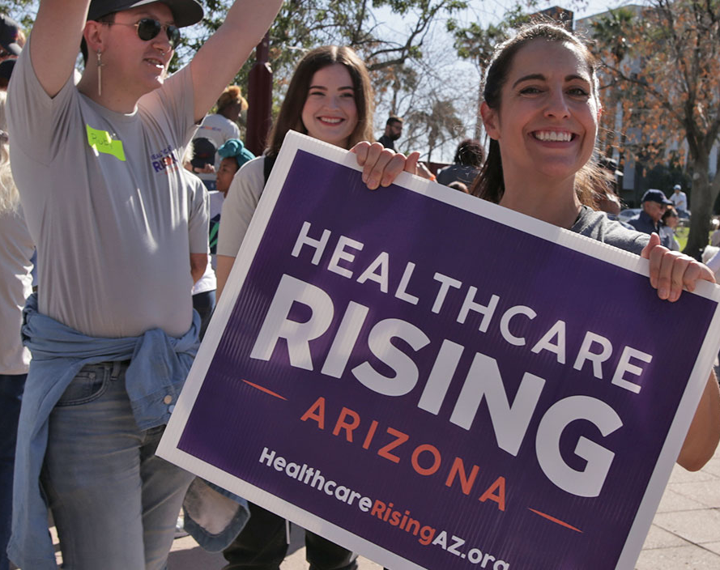

VOLUNTEER TRAINING
Predatory Debt Collection Protection Act
Learn how you can win medical debt relief!

Slide 2


Slide 3
The Predatory Debt Collection Protection Act is a citizen’s ballot initiative that would protect Arizonans from unfair medical debt.

Slide 4


Slide 5
Medical debt can devastate Arizona families
A chronic disease or sudden medical emergency can cost families tens of thousands of dollars out-of-pocket — even with insurance.
More than two-thirds of all bankruptcies are tied to debt from healthcare.
18% of Arizonans have medical bills that are past due.

Slide 6
Debt shouldn’t destroy lives
Right now, medical debt collectors can jack up interest rates to 10% a year, every year, keeping families trapped in an unending debt that increases even as they continue making payments.
Debt collectors can sue you in court to collect on debts, putting your property, income, and assets at risk. They can take away a family’s home or car and garnish wages, all of which makes it harder for people to get out of debt, and even just to get by.

Slide 7
Arizona families deserve freedom from unfair debt
If there’s a judgment against you, the ballot measure protects more of your assets from being sold to pay off debt collectors, and ensures consumers keep more of their bank accounts and wages, rather than losing their savings and income to pay off a predatory debt collector.
This limits outrageous interest rates on medical debt so that families won’t be trapped in an unending cycle.

Slide 8
Arizonans are already struggling financially
Arizonans have more debt and more debt in collections than the national average, with more than $58,000 in debt per person and 30% in collections.
38.5% of Arizonans reported at least one household member losing employment income since the beginning of 2020.
Housing prices in Arizona have been rising.

Slide 9
The Nitty Gritty
What exactly does the Protection from Predatory Debt Collection Act do?
1
2
3
4
5
Increases the protected value of people’s primary home
Increases the allowed value of protected household goods and bank accounts
Increases the protected value of vehicles
Limits wage garnishment for debt to no more than 10% of disposable earnings
Limits the interest rate on medical debt to no more than 3 percent

Slide 10

So you want to help?

Slide 11

It’s Signature Gathering Time!

Slide 12
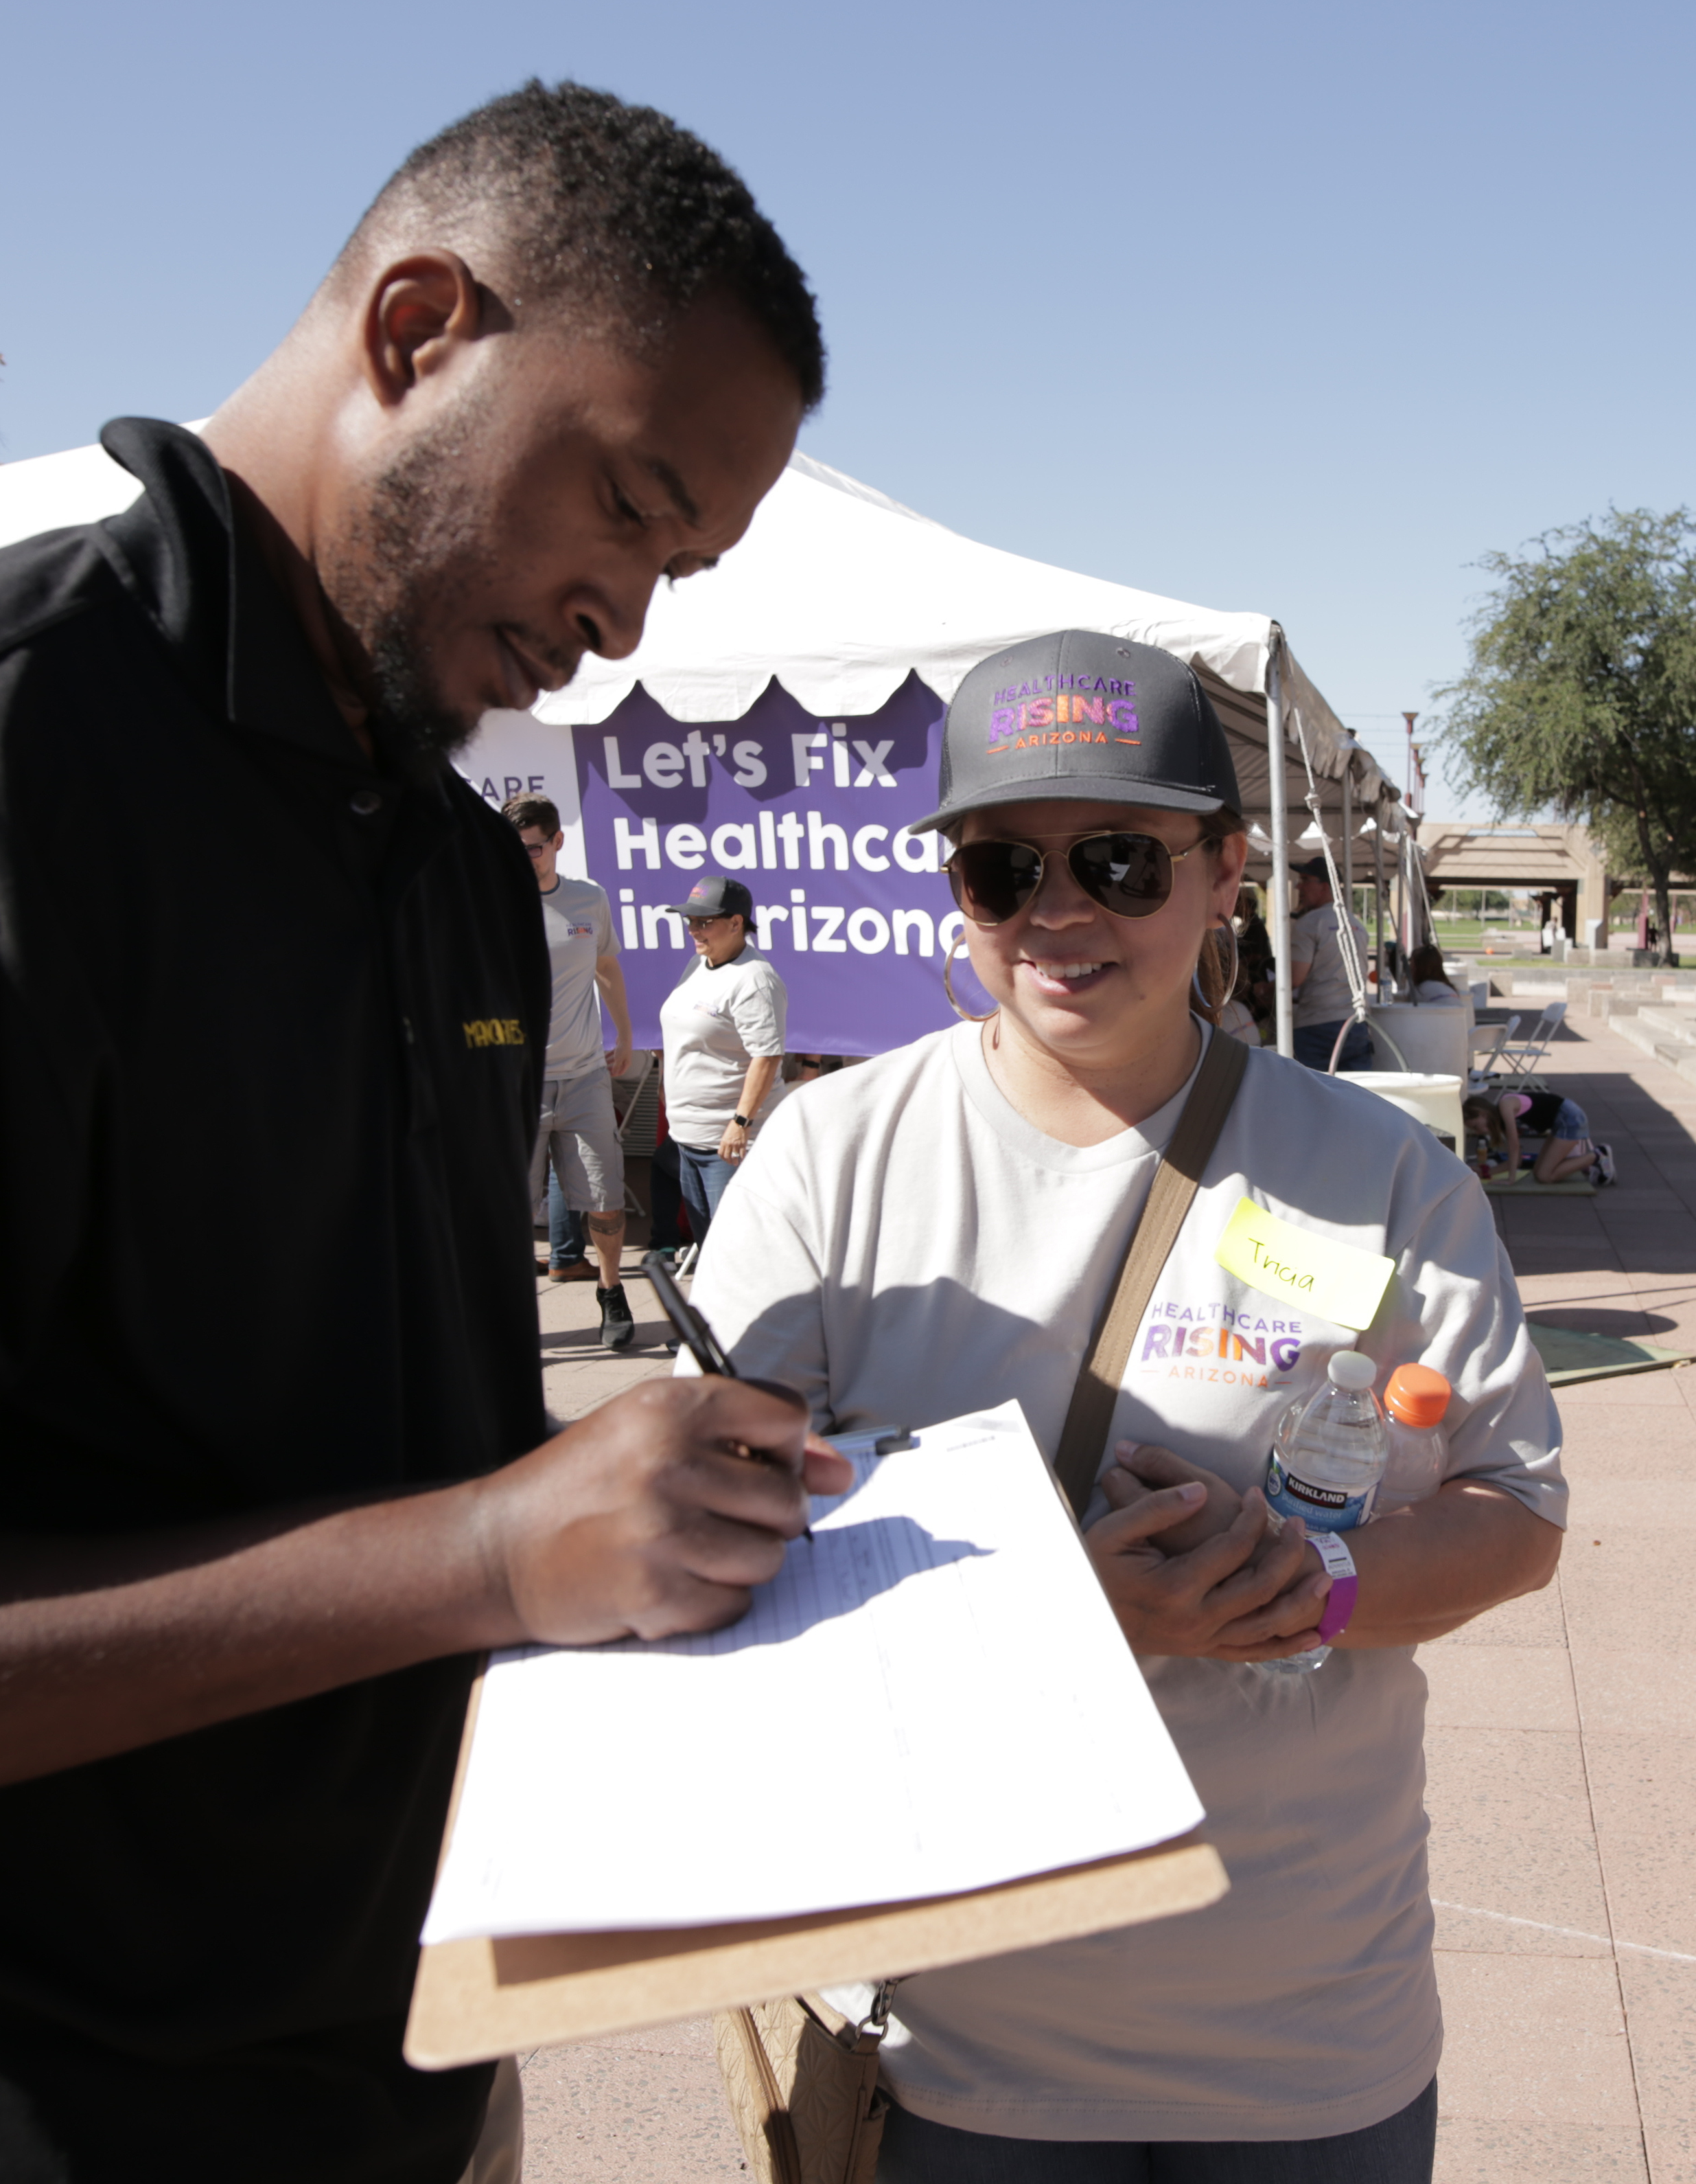
Getting
Started
Pick a location where you can find larger groups of people:
civic, faith based, progressive group meetings; college classes; grocery stores or farmers markets; friends, family, or work events
Make sure you have all the materials you need: petitions, clipboard, pen with blue or black ink, and anything to protect you from the sun if you’re gathering signatures outdoors

Slide 13
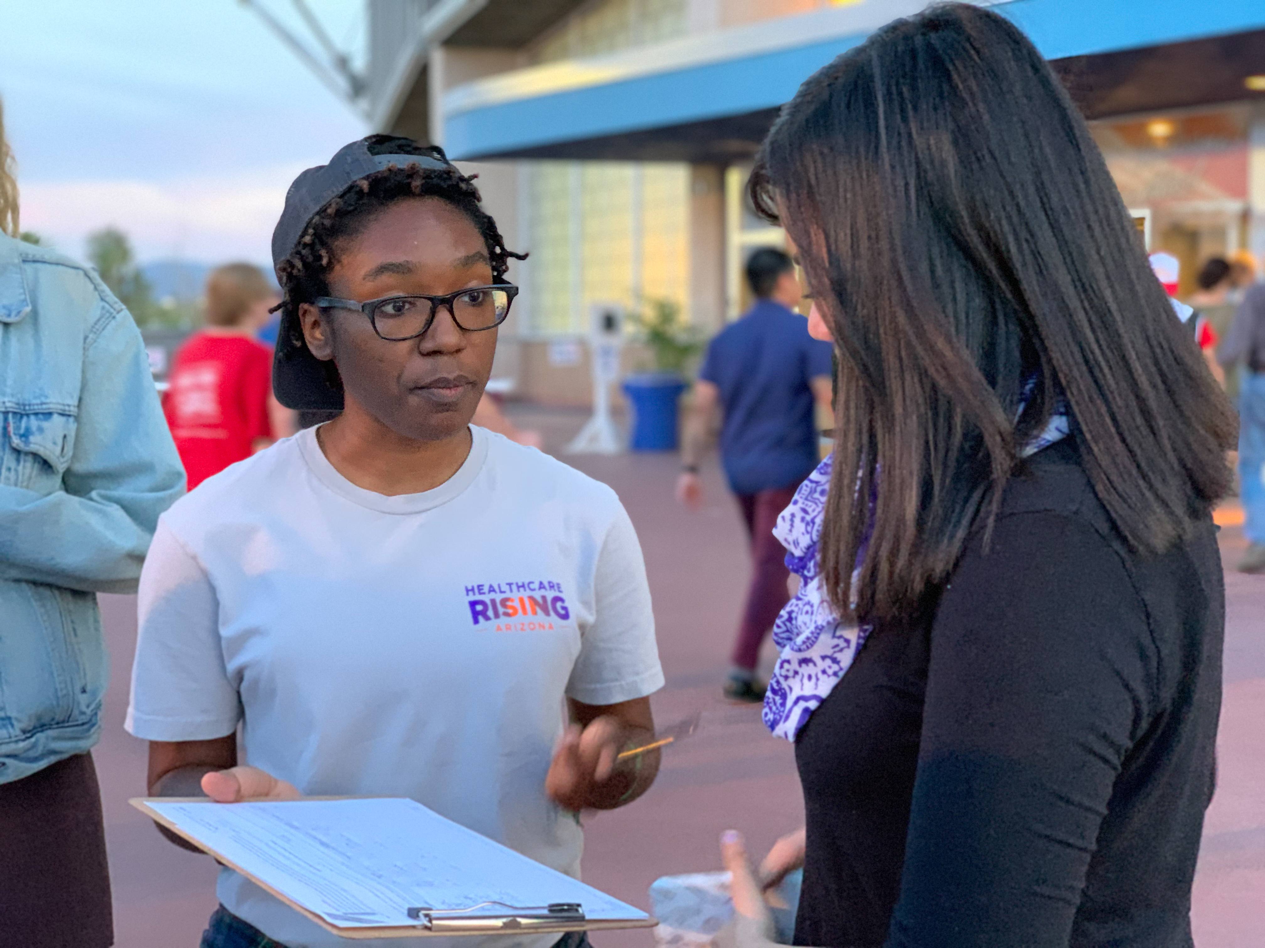
Make the Ask!
The most important part about site-based petitioning is getting people to stop.

Slide 14

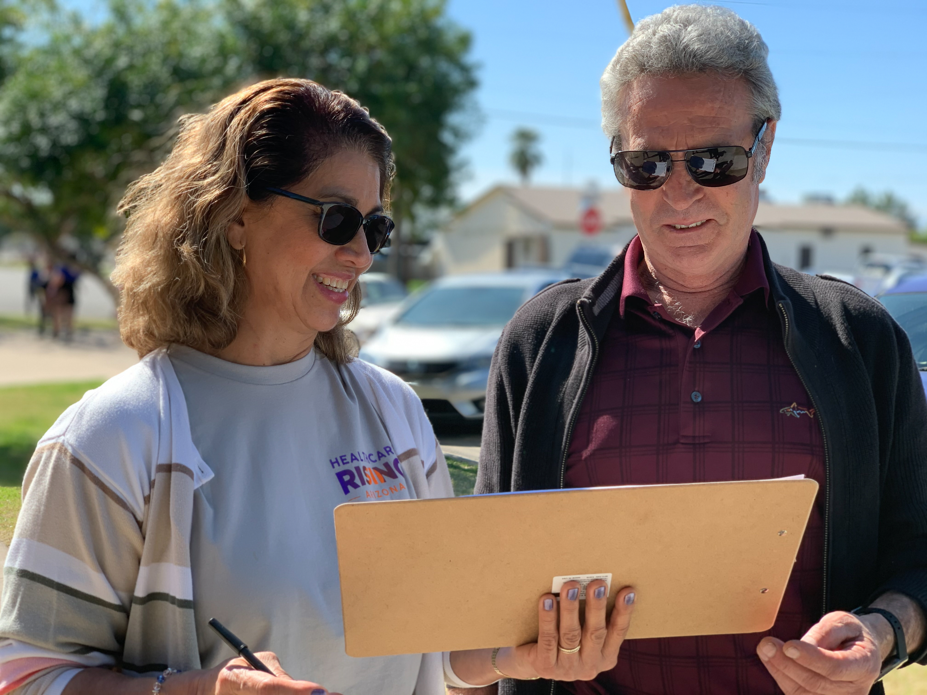
Hello — sign to support Arizona's working families!
Key Points to the Greeting
Hello — are you a registered voter in Arizona?
If they say no, thank them for their time and move on to the next person! You can’t collect 1000 signatures without also receiving a few nos.
Hello — sign to protect Arizona from predatory debt collections!
Start your greeting at least 10 feet away from the person
Smile, be friendly and welcoming
Make eye contact

Slide 15

If they say YES
Don’t freak out yet. You still need to get them to actually sign the petition properly.

Slide 16

Follow Up!
If no:
I'm working with Healthcare Rising Arizona because no Arizona family should lose their home or car, or struggle to put food on the table, due to medical emergencies or accidents, or be trapped into unending debt by unfair interest rates on medical care. Will you sign our petition to protect Arizonans from unfair medical debt?
Thank you for your time!
If yes:
Great! What county are you registered to vote in?

Slide 17
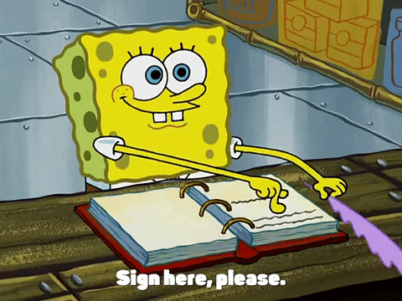
Now it’s time to sign!
Get out the correct sheet or create a new one for their county.

Slide 18
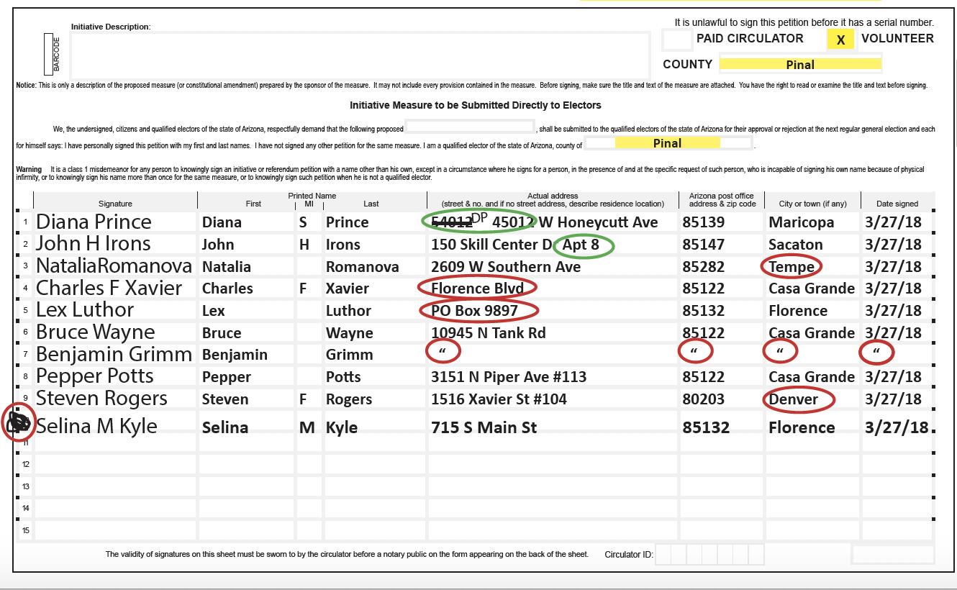


At the top of the petition, check the volunteer box and fill in the county in the two blank spaces.
Everyone signing this sheet must be from the County listed.

Slide 19

Note: The ‘Initiative Description’ and other blocks will be filled in.

Slide 20

REMEMBER:
Signers must be registered to vote in Arizona
All signers on one signature sheet must
be from the same County
Signers must fill in all information themselves.
Even if you live in the same place, you cannot
fill out the address for someone.

Slide 21
Everyone signing, must fill out the following:
Full Address (street and no.)
City/
Town
Signature
Full Name
Zip Code
Date
No street number
Must be the
same County
PO Box not allowed
Must fill out
Must be in Arizona
No marks allowed
What is wrong with the text circled in red?

Slide 22

So they signed.
Great job!
Now you got a bunch of signatures.
What’s next?

Slide 23

Take your sheets
to the notary!

Slide 24
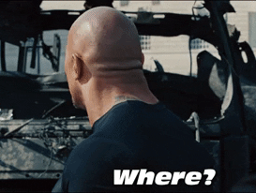
Where is the notary?
Call a HCRAZ Organizer or our office at (602) 354-8829 to find one near you
Visit any bank

Slide 25
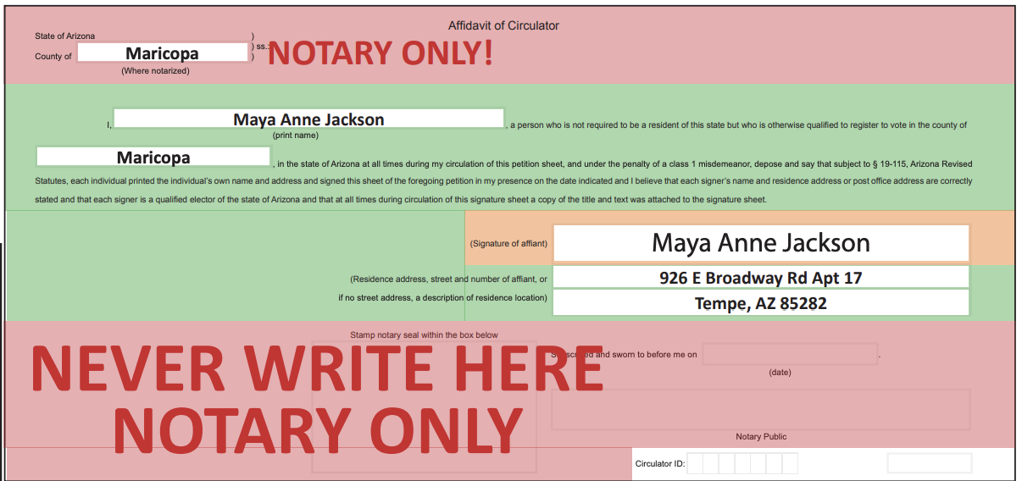

ORANGE BOX: Areas you must sign in front of the notary.
GREEN BOXES: Areas to fill out before you see the notary.
RED BOXES: Areas that ONLY the notary can write in.
Your Name
County where your office is located
Your signature
Your address

Slide 26
NOTE:
Your residence is where you live and intend
to stay. If you are visiting Arizona temporarily,
use your home address.
Do not use the address on your driver’s license if
it is not your current permanent address.

Slide 27

In Front of the Notary
It’s Ok to fill out the Green section, (Name, County, Address)
Show the notary your ID and sign, fill out your information in front of them.
Don’t fill out the top “County of _______” or any information below the line “Stamp notary seal within the box below” on the “Affidavit of Circulator” page
The RED boxes indicate areas that only the notary can write in.

Slide 28


Slide 29
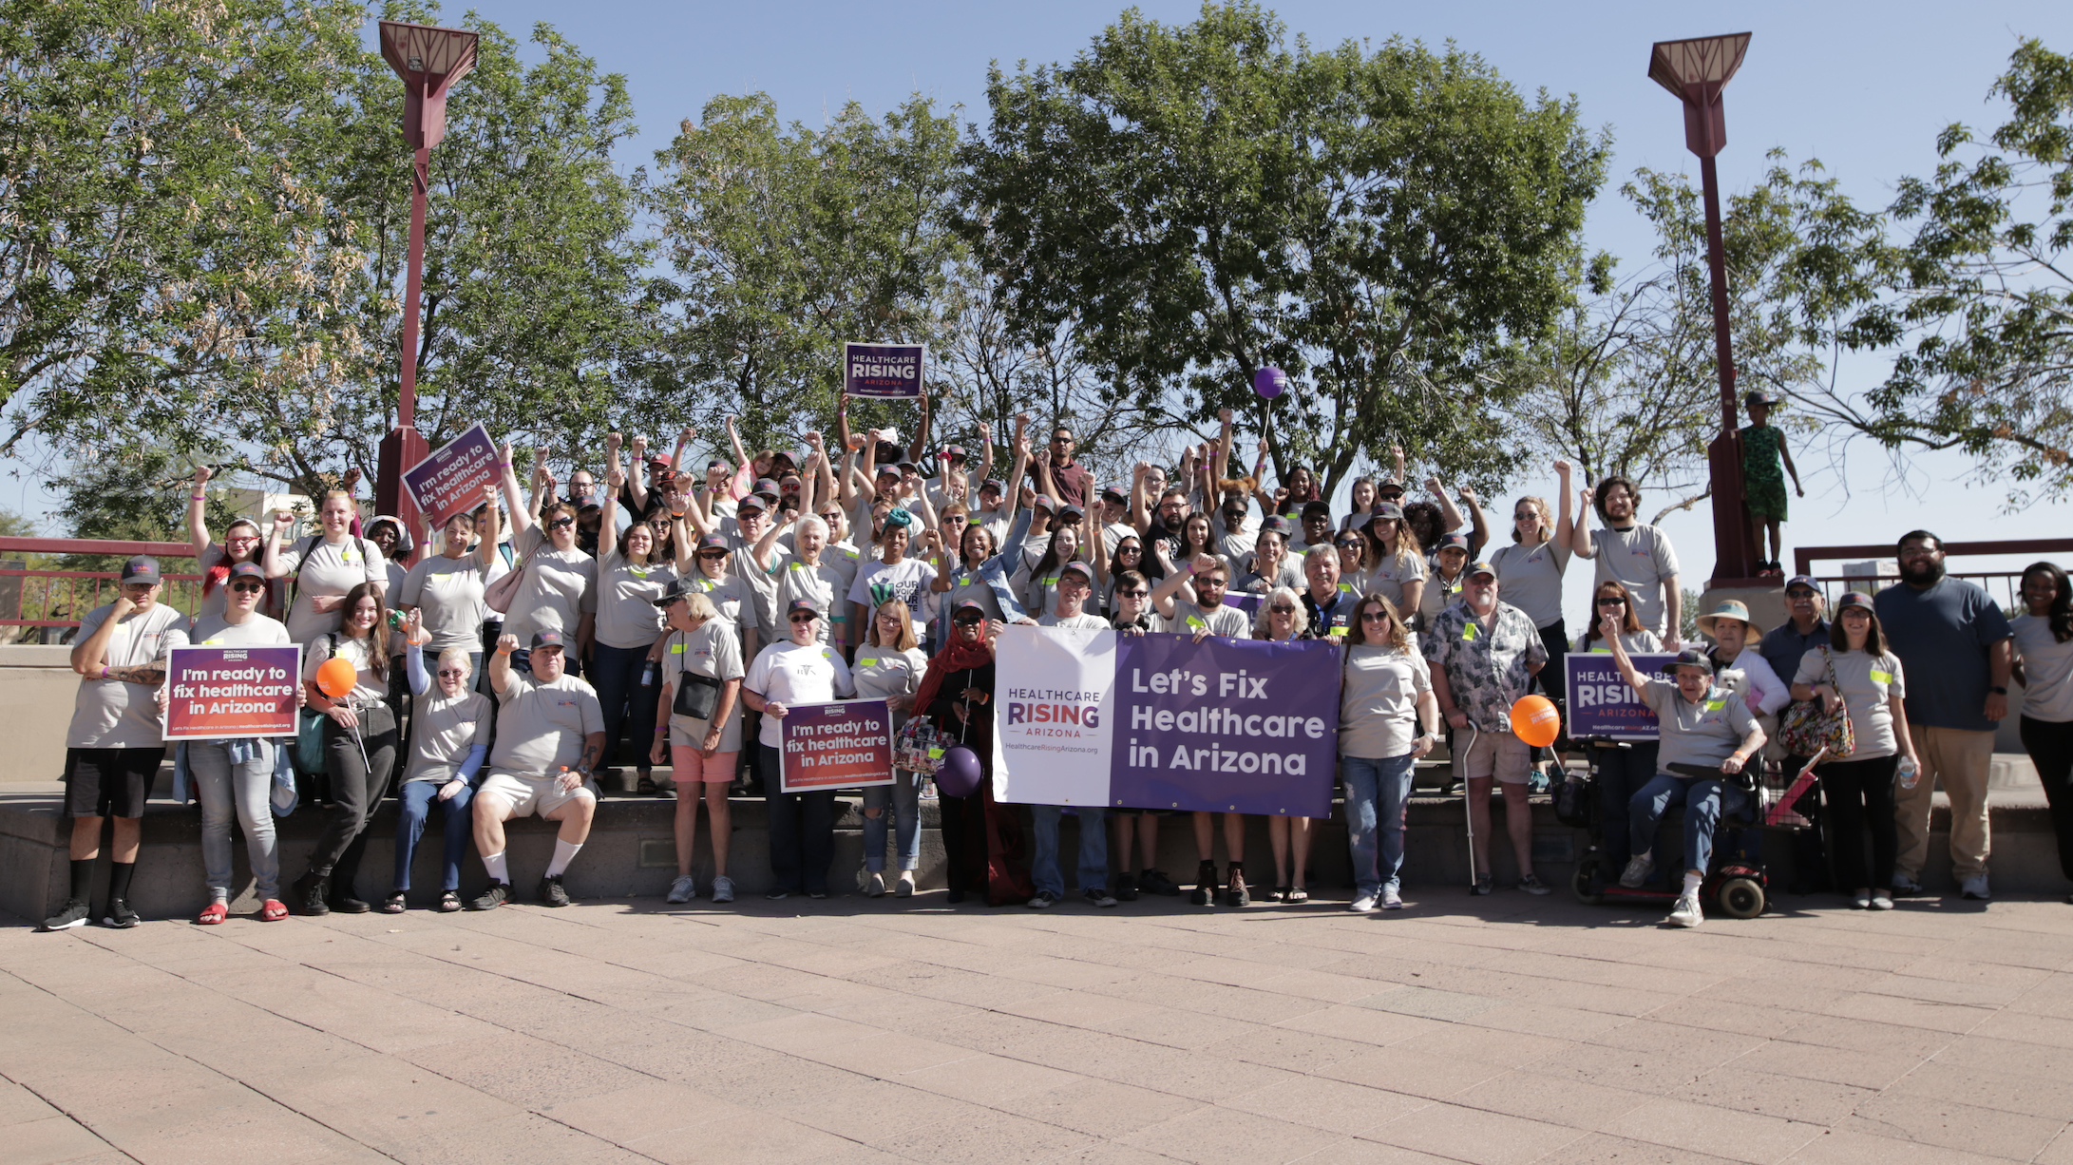
Thank you!

